Slide 1
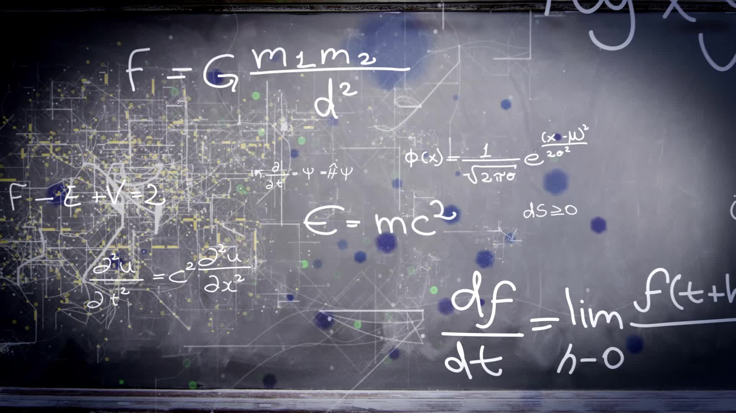
Chapter 2.1:
The Derivative and the Tangent Line Problem
HONORS CALCULUS/CALCULUS

Slide 2
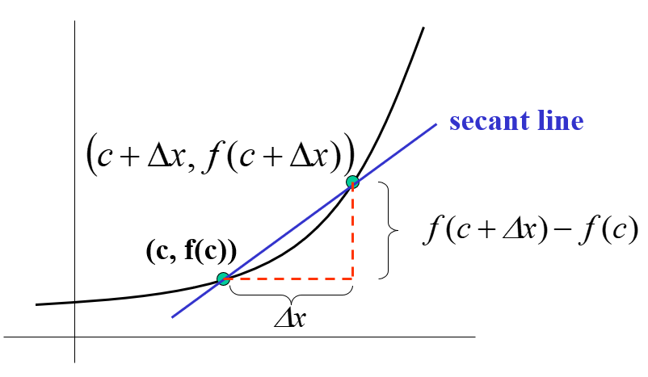
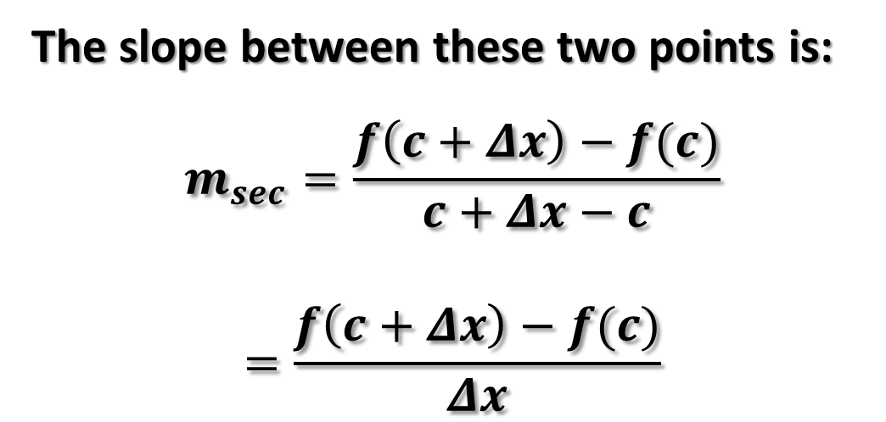
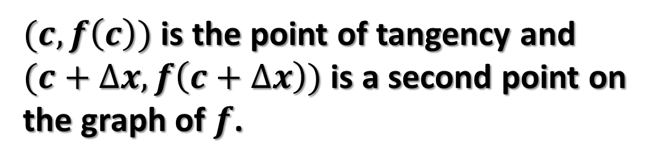
The Tangent Line Problem
$(c,f\left(c\right))$ is the point of tangency and
$(c+∆x,f\left(c+∆x\right))$ is a second point on the graph of $f$.
The slope between these two points is:
$$m_{sec}=\frac{f\left(c+Δx\right)−f(c)}{c+Δx−c}$$
$$=\frac{f\left(c+Δx\right)−f(c)}{Δx}$$

Slide 3
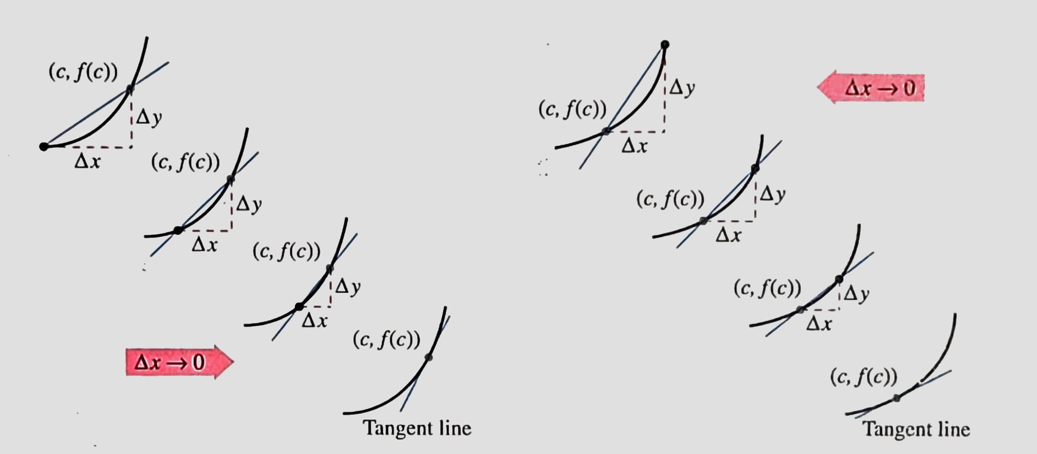
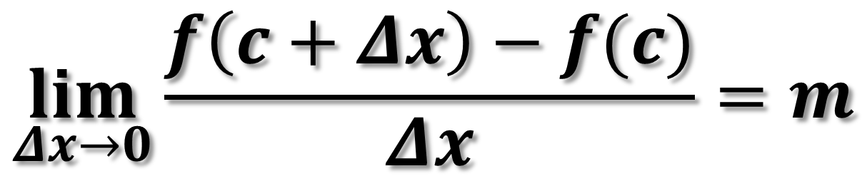
Definition of Tangent Line with Slope m
$$\lim_{Δx→0}{\frac{f\left(c+Δx\right)−f(c)}{Δx}=m}$$

Slide 4
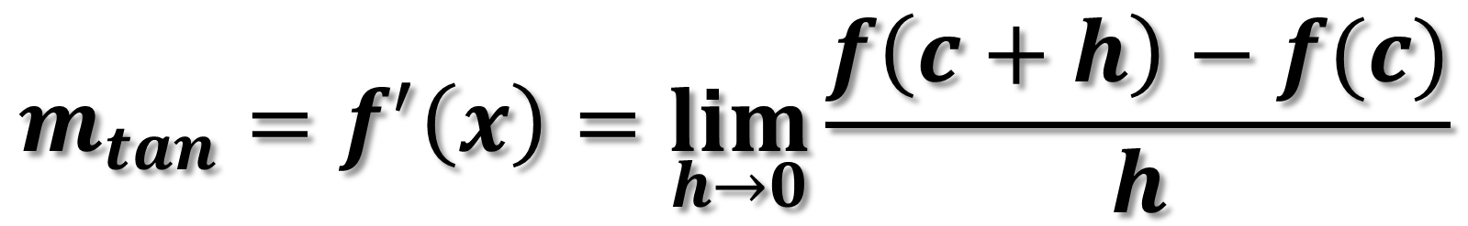
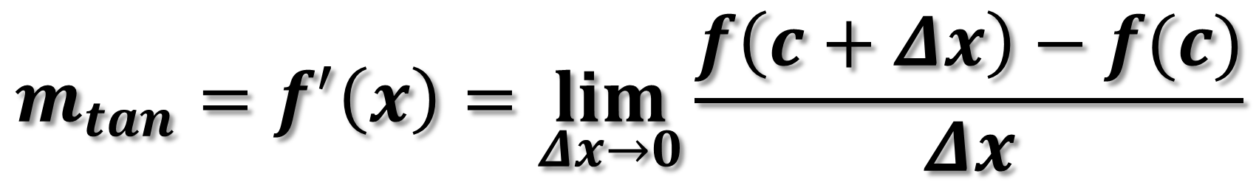
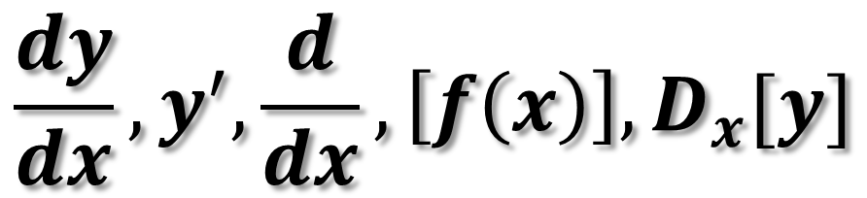
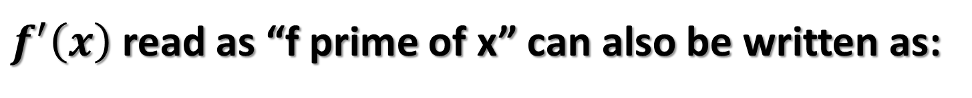
Definition of a Derivative of a Function
$$m_{tan}=f^{′}\left(x\right)=\lim_{Δx→0}{\frac{f\left(c+Δx\right)−f(c)}{Δx}}$$
OR
$$m_{tan}=f^{′}\left(x\right)=\lim_{h→0}{\frac{f\left(c+h\right)−f(c)}{h}}$$
$f^{′}\left(x\right)$ read as “f prime of x” can also be written as:
$$\frac{dy}{dx}, y^{′},\frac{d}{dx}, \left[f\left(x\right)\right], D_{x}[y]$$

Slide 5

















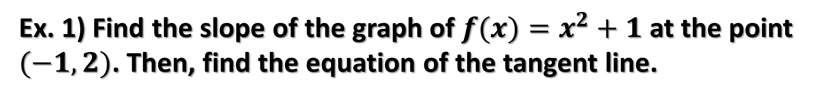
















Ex. 1) Find the slope of the graph of $f(x)=x^{2}+1$ at the point $(−1,2)$. Then, find the equation of the tangent line.

Slide 6






















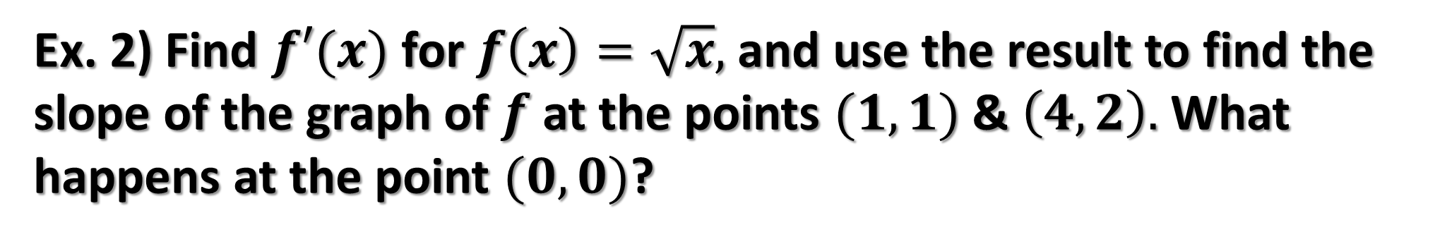
Ex. 2) Find $f′(x)$ for $f\left(x\right)=\sqrt{x},$ and use the result to find the slope of the graph of $f$ at the points $(1,1)$& $\left(4,2\right).$What happens at the point $(0,0)$?

Slide 7
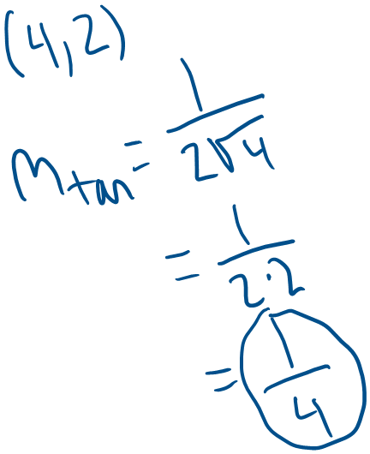
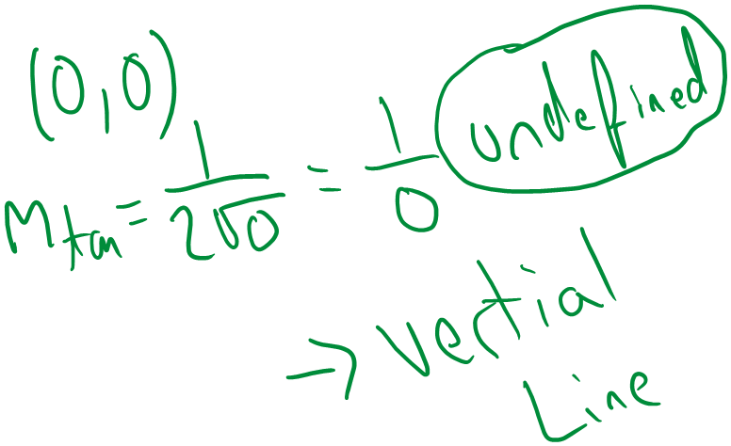
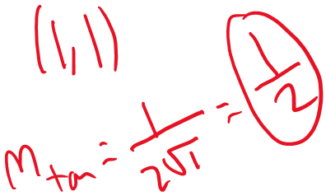
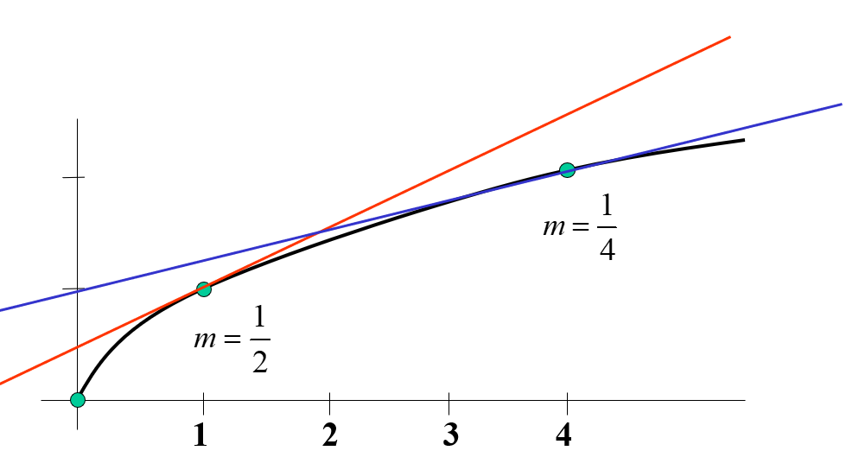






Slide 8
















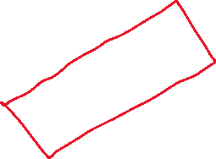


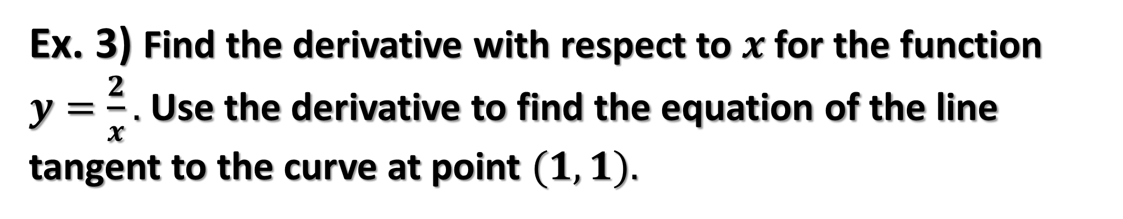






Ex. 3) Find the derivative with respect to $x$ for the function $y=\frac{2}{x}.$ Use the derivative to find the equation of the line tangent to the curve at point $(1,1).$

Slide 9
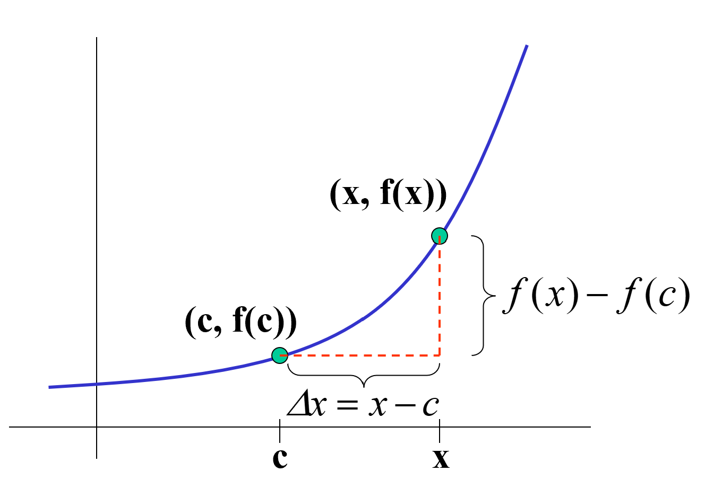
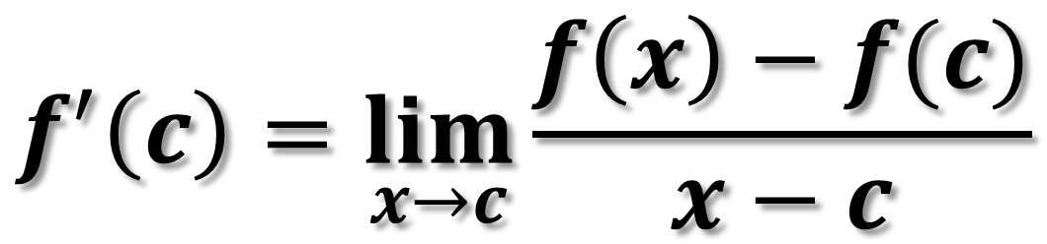
Theorem 3.1: Alternate Form of the Derivative
$$f^{′}\left(c\right)=\lim_{x→c}{\frac{f\left(x\right)−f(c)}{x−c}}$$

Slide 10
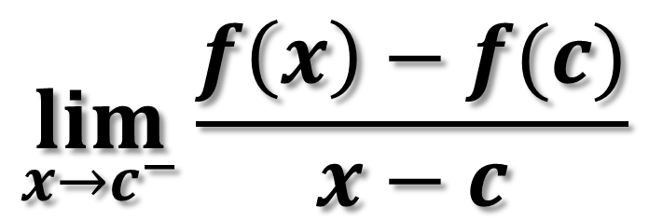
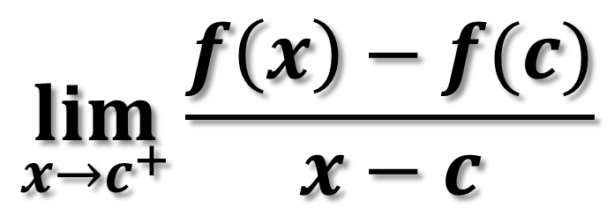
Derivatives from the Left and the Right
$$\lim_{x→c^{−}}{\frac{f\left(x\right)−f(c)}{x−c}}$$
$$\lim_{x→c^{+}}{\frac{f\left(x\right)−f(c)}{x−c}}$$

Slide 11
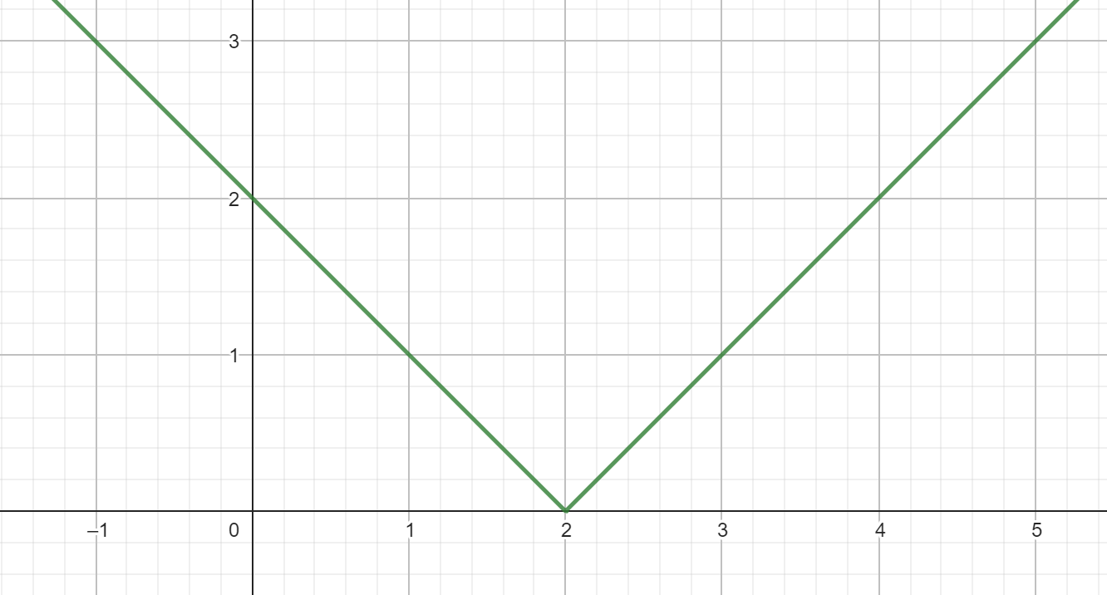




















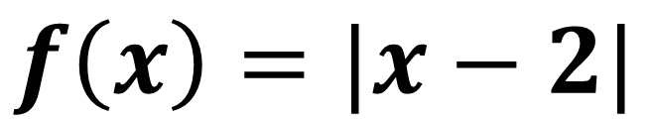



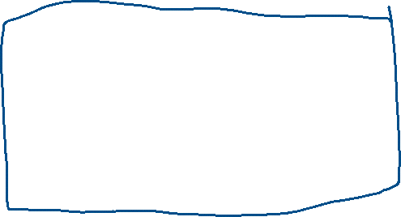


Ex. 4) Find the derivative of $f(x)$ as $x→2$.
$$f\left(x\right)=|x−2|$$

Slide 12
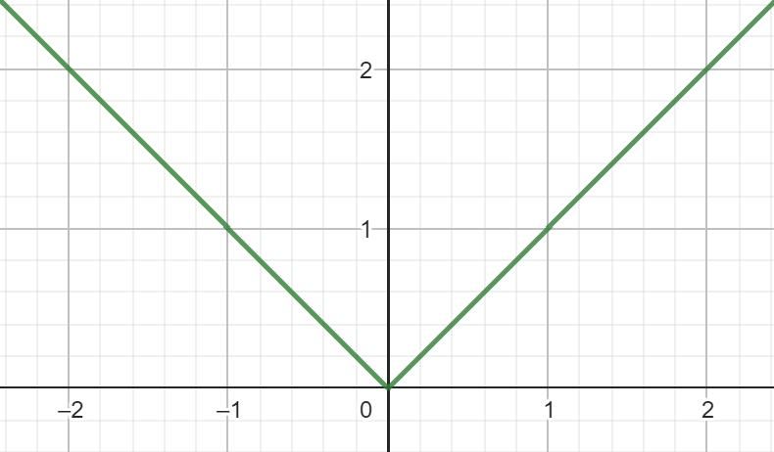
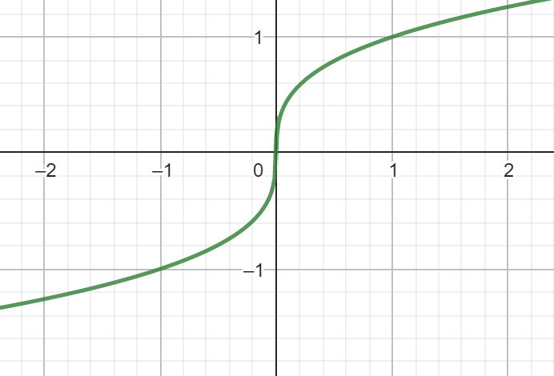
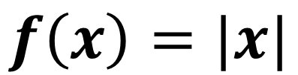
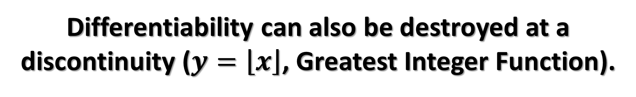
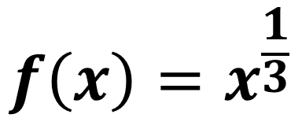
A function is not differentiable at a point at which its graph has a sharp turn or a vertical tangent line.
$$f\left(x\right)=x^{\frac{1}{3}}$$
$$f\left(x\right)=|x|$$
Differentiability can also be destroyed at a discontinuity ($y=\left\lfloor x\right\rfloor$, Greatest Integer Function).

Slide 13
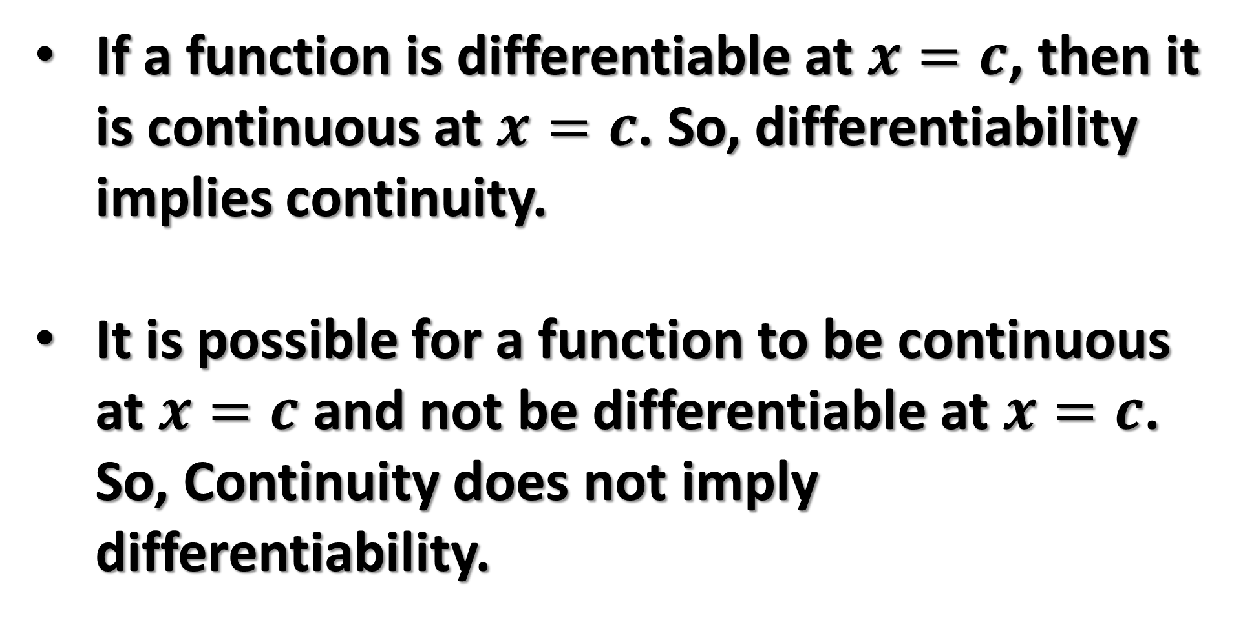
The Relationship Between Continuity and Differentiability
If a function is differentiable at $x=c$, then it is continuous at $x=c$. So, differentiability implies continuity.
It is possible for a function to be continuous at $x=c$ and not be differentiable at $x=c$. So, Continuity does not imply differentiability.

